Slide 1
Fast Fourier Transform

Slide 2
Agenda
Historical Introduction
CFT and DFT
Derivation of FFT
Implementation

Slide 3
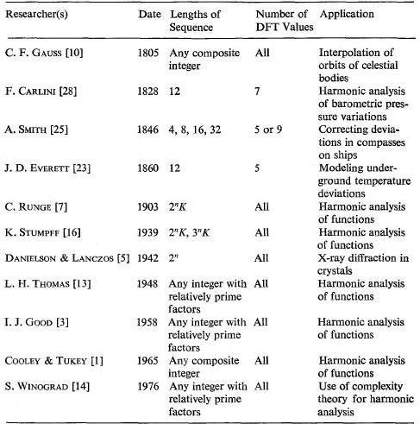
Historical Introduction

Slide 4
Continuous Fourier Transform (CFT)
Given:
Complex Fourier Coefficient:
Fourier Series:
(change of basis)

Slide 5
Discrete Fourier Transform
Given:

Slide 6
Discrete Fourier Transform
Fourier-Matrix
DFT of x:
Matrix-Vector-Product:
N^2 Multiplications
N(N-1) Additions
Arithmetic Complexity: O(N^2)

Slide 7
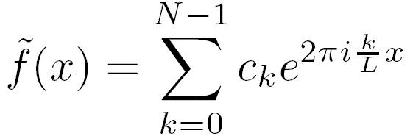
Trigonometric Interpolation
Given: equidistant samples of i.e.
Goal: find such that with

Slide 8
Trigonometric Interpolation
Theorem:
=> Inverse DFT!

Slide 9
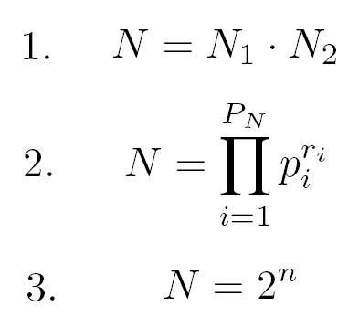
Derivation of FFT

Slide 10
FFT – Lower Bound:
(S. Winograd – Arithmetic Complexity of Computations 1980 CBMS-NSF, Regional Conference Series in Applied Mathematics)

Slide 11
FFT if N is prime
Two approaches:

Slide 12
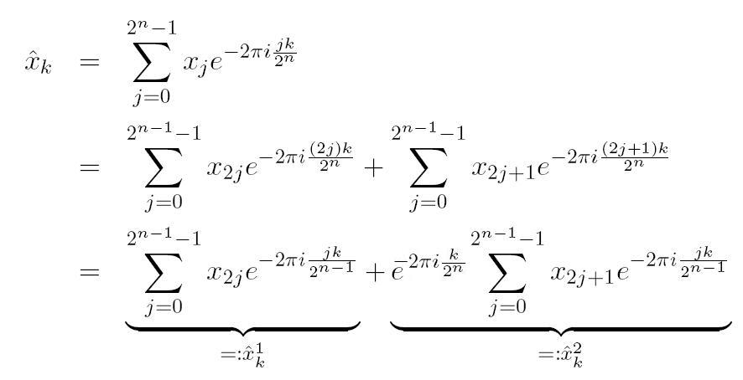
Implementation (N = power of 2)

Slide 13
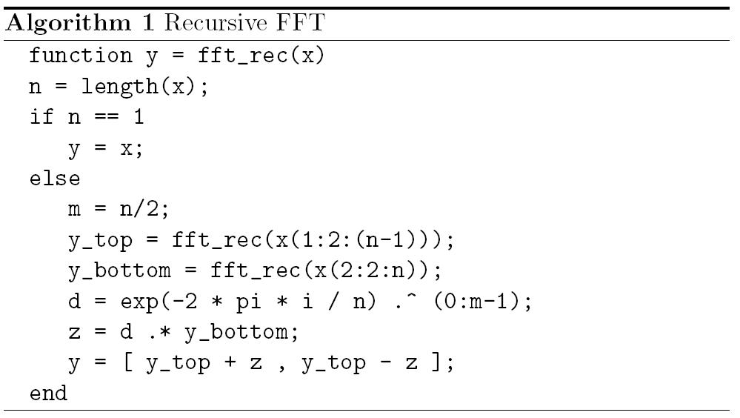
Recursive Implementation

Slide 14
Recursive Implementation
Stack-Problem:
Space Complexity: O(NlogN)
Better Approach:
Iterative Implementation => in place! (O(N))

Slide 15
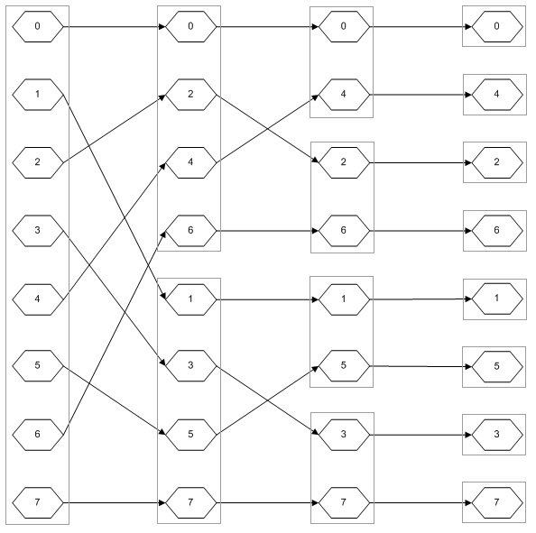
Iterative Implementation (N=8)

Slide 16
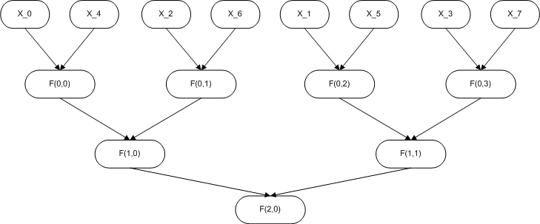
Iterative Implementation (N=8)

Slide 17
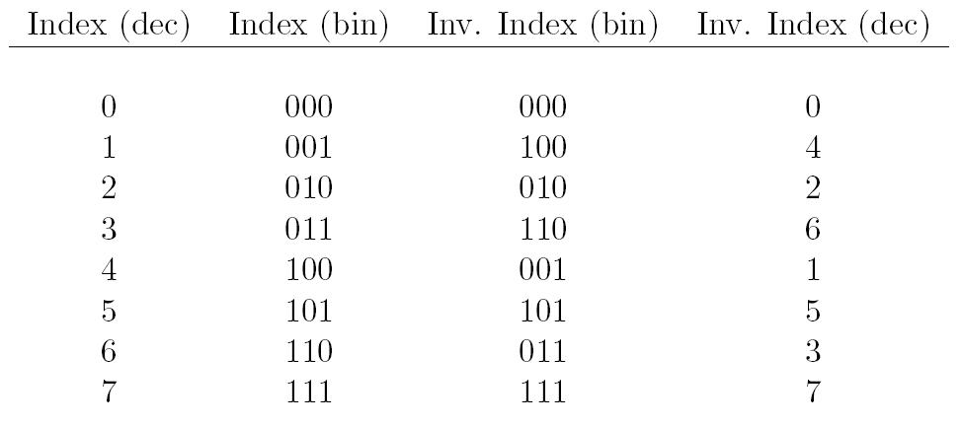
Iterative Implementation (N=8)
Bit-Inversion:

Slide 18
Iterative Implementation
Theorem:
The bit inversion yields the result of the permutation graph.

Slide 19
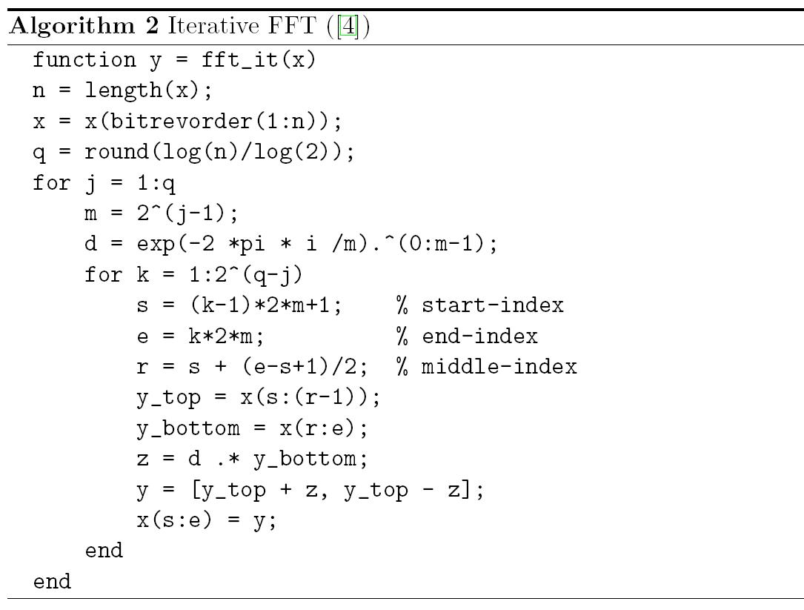
Iterative Implementation

